Slide 1
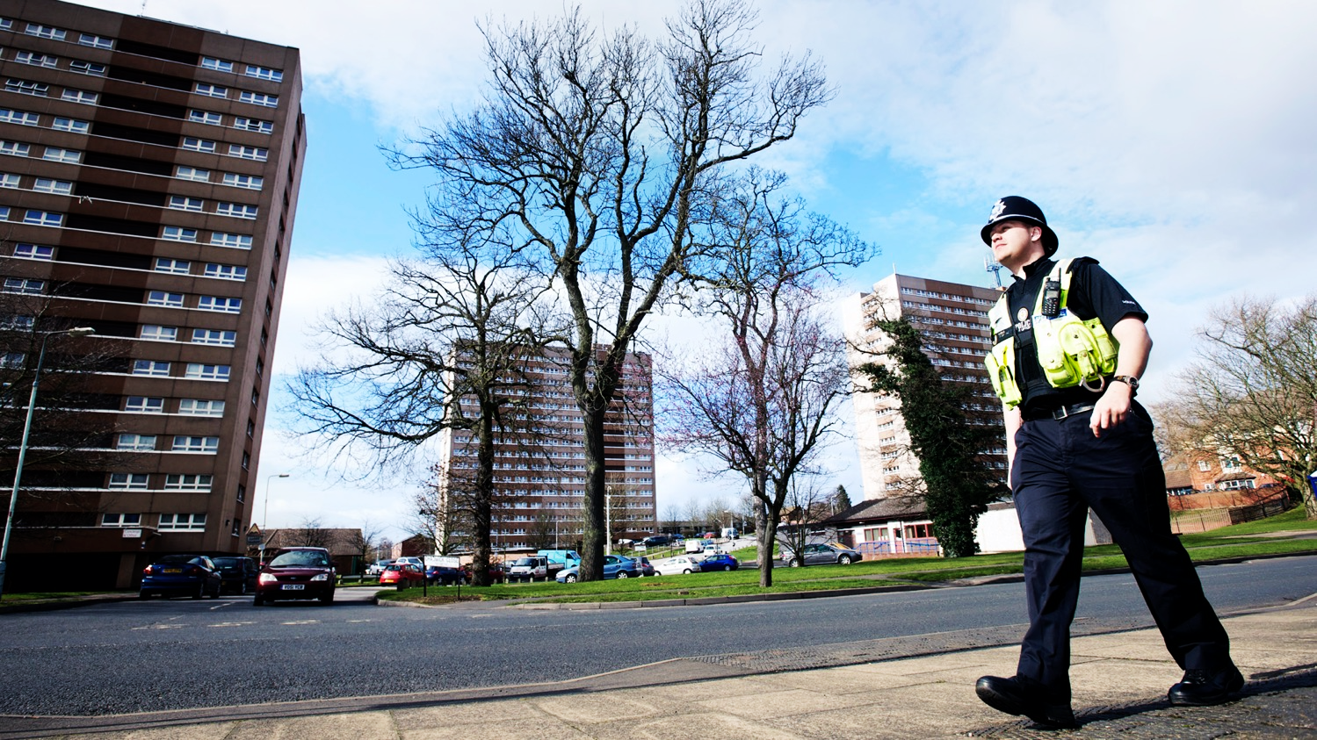

10 tips for effective problem solving Dr Matt Ashby
JILL DANDO INSTITUTE OF SECURITY & CRIME SCIENCE
Image: West Midlands Police

Slide 2
1
Be specific

Slide 3
Robbery
Commercial robbery
Personal robbery
Off-licence robbery
Cash-in-transit robbery
…
Home invasion
Car-jacking
Phone robbery
…
Outside Tube stations
Outside schools
Late at night
…

Slide 4
2
Be much more specific

Slide 5
Phone robberies outside schools
Phone robberies outside two secondary schools at school finishing time
Phone robberies within 200m of two secondary schools at school finishing time by offenders from a local gang

Slide 6
3
Make (a little) time for analysis

Slide 7
Repeat offending
Journey to crime
Facilitators
Social networks
Intelligence interviews
Repeat victimization
Near-repeat victimization
Victim–offender overlap
offenders
targets
Hotspots
Place managers
places

Slide 8
4
Don’t get captured by the process

Slide 9
Scanning
Analysis
Response
Assessment

Slide 10
5
Remember that some benefit is better than none

Slide 11
Reduce the volume of the problem
Reduce the harm the problem causes
Reduce the concentration of the harm
Reduce the community’s perception of the problem

Slide 12
6
Ask yourself: what has to happen for my plan work?

Slide 13
Action
Mechanism
Effect
Weapons sweep
Weapons not available
Fewer stabbings
Bike marking
?
Fewer stabbings

Slide 14
7
Choose achievable responses

Slide 15

Image: The Telegraph of India

Slide 16
8
Ask yourself: what might stop my plan from working?

Slide 17
Weapons sweep
Weapons not available
Fewer stabbings

Slide 18
9
Have an exit plan

Slide 19
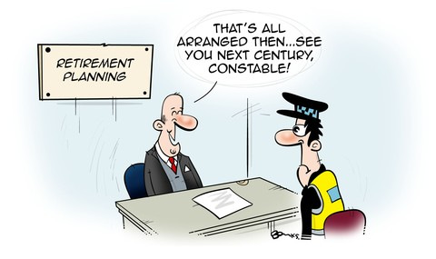
Image: Police Oracle

Slide 20
10
Measure achievement, not activity

Slide 21
★☆☆☆☆
3 days of action
★★☆☆☆
5 people prosecuted
★★★★☆
50% reduction in crime

Slide 22
Slides: lesscrime.info/slides/london-pop-2023 Contact: matthew.ashby@ucl.ac.uk or @lesscrime
JILL DANDO INSTITUTE OF SECURITY & CRIME SCIENCE
Image: West Midlands Police

